Slide 1
Attention Is All You Need
by
Ashish Vaswani Noam Shazeer Niki Parmar Jakob Uszkoreit
Llion Jones Adian N. Gomez Lukasz Kaiser Illia Polosukhin
Presentation by
Zane Bayer, PhD student, Applied Science Dept.

Slide 2
The Roadmap
Prerequisites
Introduction & Background
Model Architecture: The Transformer
Training and Results
Authors’ Conclusion
Since 2017 and Learning Diagram

Slide 3
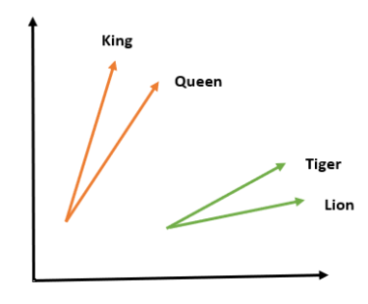

Prerequisites: Word Embedding
‘The cat jumped over the mat’
context matters!
The ‘dictionary’ indices of these words are
$v=$[2230, 450, 1100, 1500, 2230, 1250]
The word embedding is
$${\overset{⃑}{e}}_{i}=WE\left(v_{i}\right)∈ℝ^{d_{model}}$$
where $d_{model}=512$
Build your own Movie Recommendation Engine using Word Embedding – Capable Machine

Slide 4
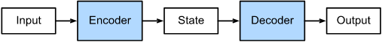
Prerequisites: The Encoder-Decoder Architecture
Encoder-Decoder networks handle mappings from variable length inputs to variable length outputs
At it’s heart, the transformer is simply a encoder-decoder neural network with some clever (learned) matrix operations between layers

Slide 5
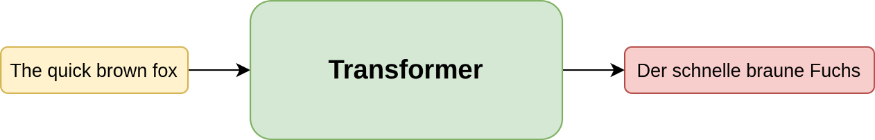
Introduction & Background: The problem we want to solve
Machine Translation
Machine translation performance is scored with the BLEU score
The real challenge is finding a model which captures long-range dependencies in the data
Understanding Transformers, the Data Science Way – R. Agarwal

Slide 6

Introduction & Background: The Problem With LSTMs
Captures long-range dependencies well, but cannot run in parallel
Understanding LSTM Networks – C. Olah

Slide 7
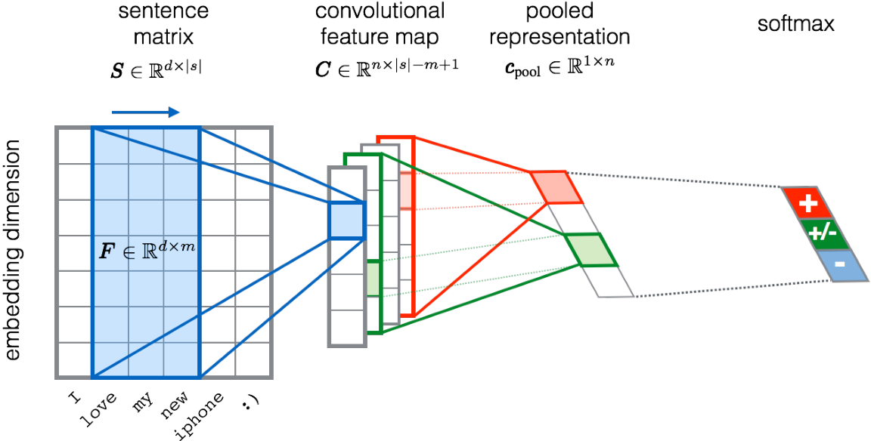
Introduction & Background: The Problem With Convolution
CNN’s for machine translation can be run in parallel, but the number of operations grows as the distance between positions grows
UNITN: Training Deep Convolutional Neural Network for Twitter Sentiment Classification – A. Severyn et al

Slide 8
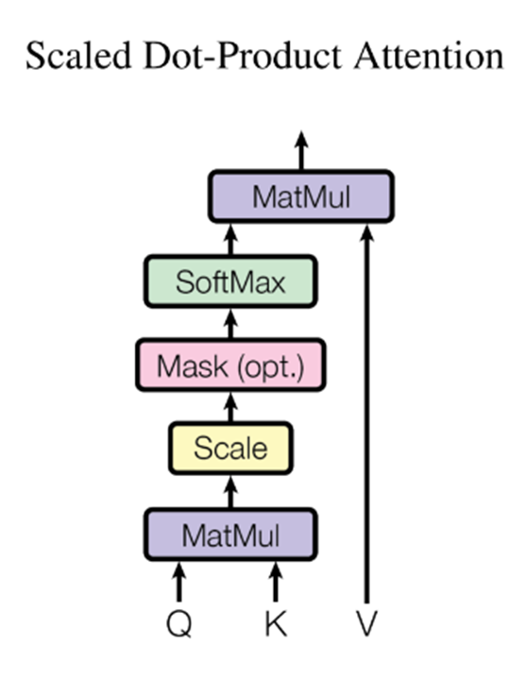
Introduction & Background: The Solution Is Attention
Attention can be calculated in parallel and only requires a constant number of operations.
The transformer is the first model to rely entirely on self-attention mechanisms

Slide 9
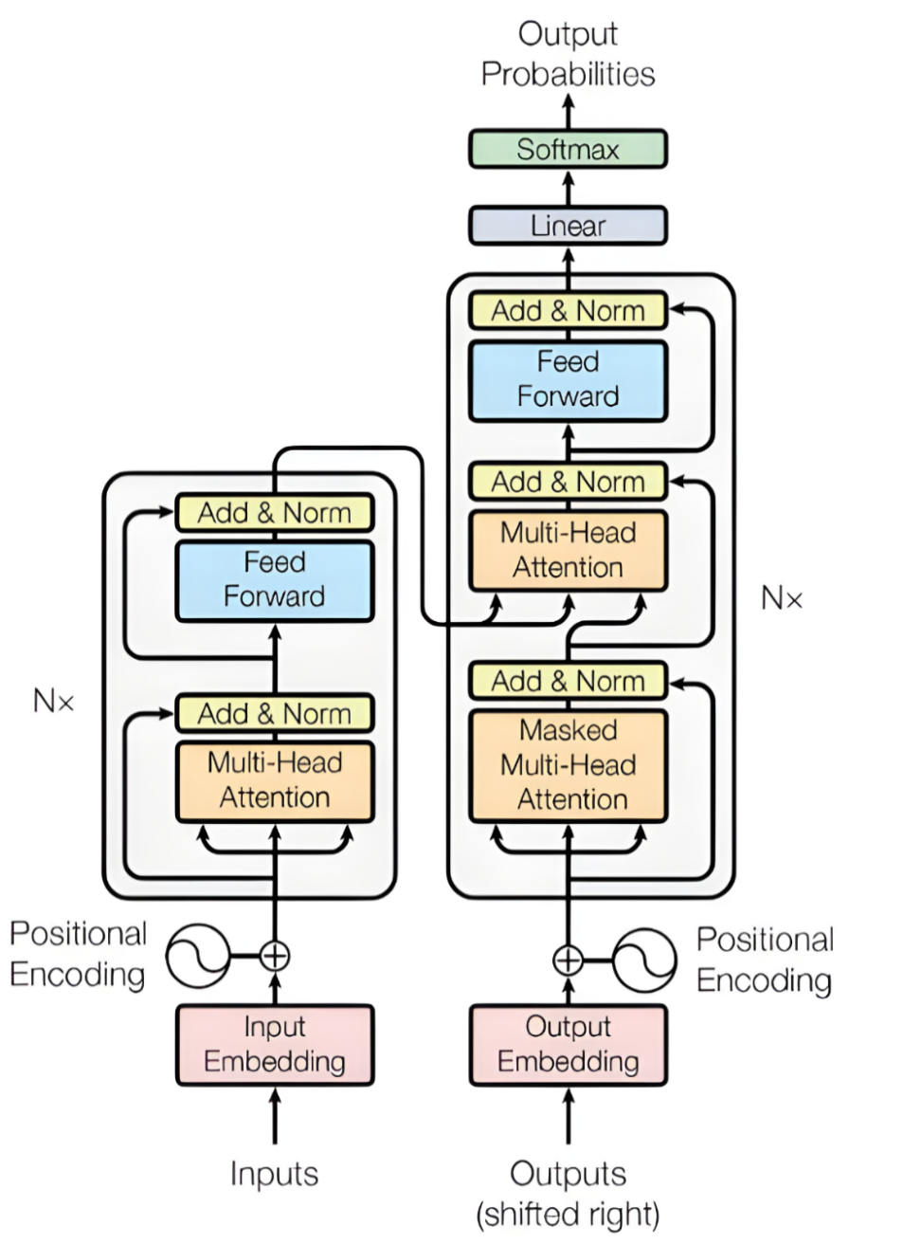
Model Architecture: The Transformer
How is positional information encoded?
What is attention and how is it used in the transformer?
How does information flow through the transformer?

Slide 10





Model Architecture: Word & Positional Embeddings
The Transformer uses a learned word embedding. The positional embedding given by
${PE}_{(pos,2i)}=sin⁡(pos/{10000}^{2i/d_{model}}$)
$PE_{(pos,2i+1)}=cos⁡(pos/{10000}^{2i/d_{model}}$)
‘The Cat jumped over the mat’: 6 words, 6 positional vectors
${\overset{⃑}{p}}_{pos}=\left[sin\left(\frac{pos}{{10000}^{\frac{0}{d_{model}}}}\right),cos\left(\frac{pos}{{10000}^{\frac{2}{d_{model}}}}\right),sin\left(\frac{pos}{{10000}^{\frac{4}{d_{model}}}}\right), …\right]$ where $\overset{⃑}{p}∈ℝ^{d_{model}}$
$$i=0$$
$$i=1$$
$$i=2$$
Transformer Architecture: The Positional Encoding – Amirhossein Kazemnejad

Slide 11

Model Architecture: Word & Positional Embeddings
The word and positional embeddings are added together and given to the transformer
Let’s denote an embedded English sentence as
$$E=\left[ {\overset{⃑}{e}}_{0}+{\overset{⃑}{p}}_{0},{\overset{⃑}{e}}_{1}+{\overset{⃑}{p}}_{1}, …,{\overset{⃑}{e}}_{n}+{\overset{⃑}{p}}_{n}\right]$$
and the embedded German sentence as
$$G=\left[ {\overset{⃑}{g}}_{0}+{\overset{⃑}{p}}_{0},{\overset{⃑}{g}}_{1}+{\overset{⃑}{p}}_{1}, …,{\overset{⃑}{g}}_{m}+{\overset{⃑}{p}}_{m}\right]$$
So the encoded sentences have dimensions $E∈ ℝ^{d_{model} ×n}$ and $G∈ ℝ^{d_{model} ×m}$

Slide 12
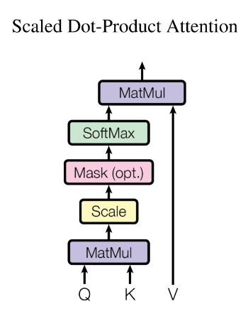

Model Architecture: Attention
$$Attention\left(Q,K,V\right)=softmax\left(\frac{{QK}^{T}}{\sqrt{d_{k}}}\right)V$$
where Q is a matrix of queries, K is a matrix of keys, V
is a matrix of values, and $d_{k}$ is a scalar
Attention captures similarity

Slide 13
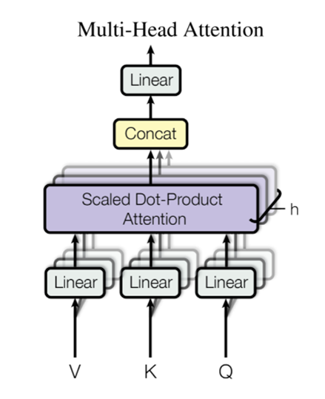

Model Architecture: Multi-Head Attention
$$MulitHead\left(Q,K,V\right)=Concat\left({head}_{1}, …, {head}_{h}\right)W^{O}$$
where ${head}_{i}=Attention\left({QW}_{i}^{Q}, {KW}_{i}^{K}, {VW}_{i}^{V}\right)$
for
$$W^{O}∈ℝ^{hd_{v} × d_{model}}$$
$$W_{i}^{Q}, W_{i}^{K}∈ ℝ^{d_{model} × d_{k}}$$
$$W_{i}^{V}∈ℝ^{d_{model} × d_{v}}$$
Allows the model to learn from multiple projections of the
data.

Slide 14
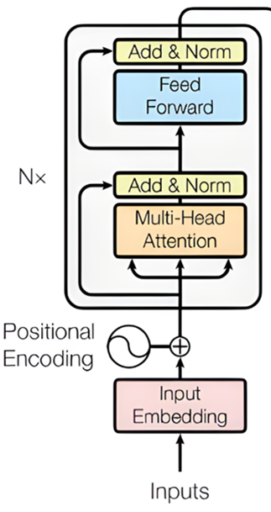

Model Architecture: The Encoder
Learns how the context and order of the English sentence matters for translation
Sublayers: Multi-Head Attention and FFN with residuals connections
Q,K, and V are some form of the embedded English $E$

Slide 15
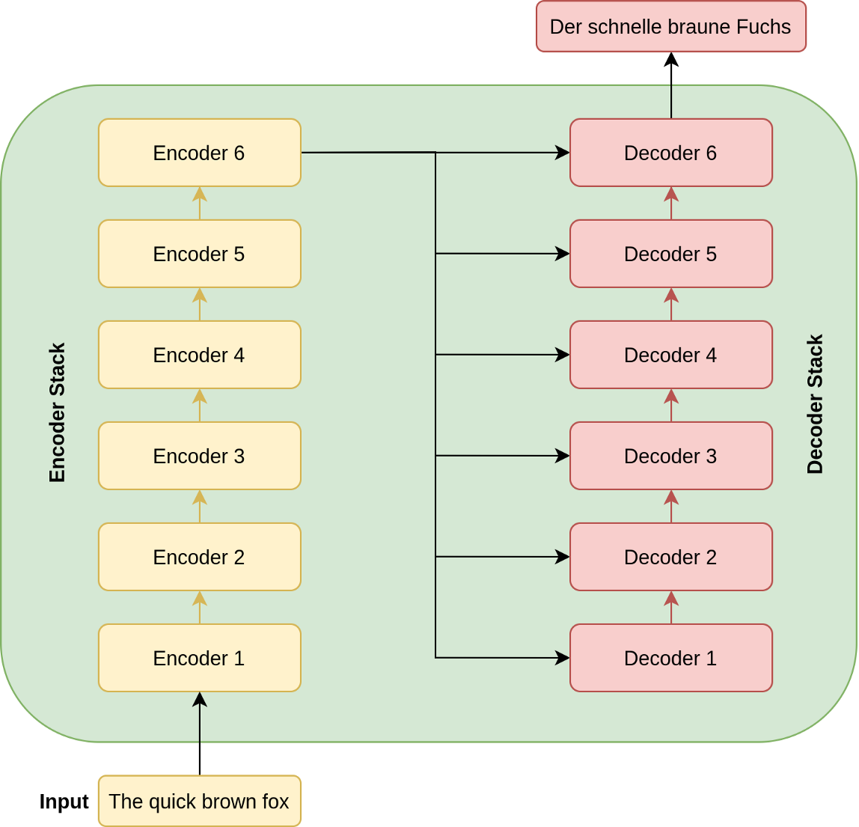
Model Architecture: From Encoder to Decoder
The ‘encoded’ English sentence is given to each decoder in the stack
Understanding Transformers, the Data Science Way – R. Agarwal

Slide 16
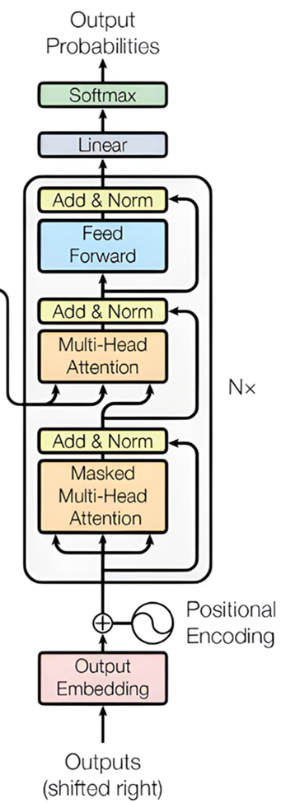

Model Architecture: The Decoder
Learns how context and order of the encoded English sentence and German sentence matter for translation
Sublayers: 2 attention Multi-Head Attention and a FFN with residual connections
The masked multi-head attention sublayer only receives translated sentence up to position $i$
Q,K, and V are different in the two attention mechanisms

Slide 17
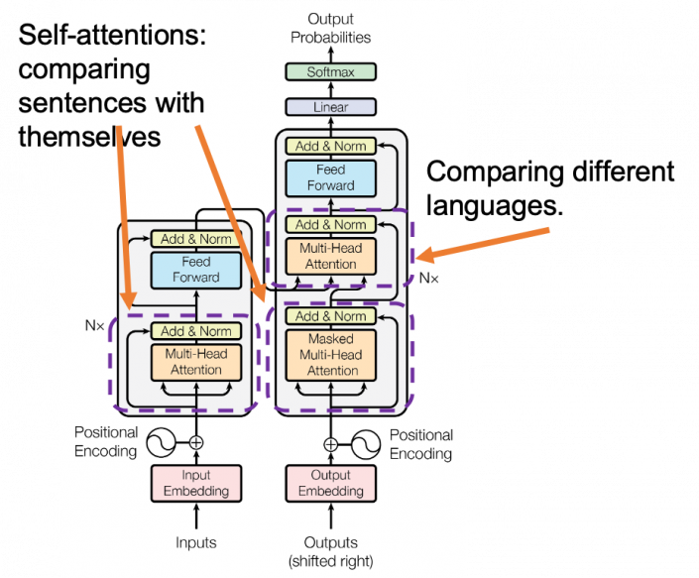

Model Architecture: Attention In the Transformer
Attention is used in 3 places:
The encoder: Q,K, and V from $E$
The Decoder: Q,K, and V from $G$
Encoder-Decoder Connection: Q from $G$, K and V from encoded $E$
position and context together!
Multi-head attention mechanism: “queries”, “keys”, and “values,” over and over again – Y. Tamura

Slide 18
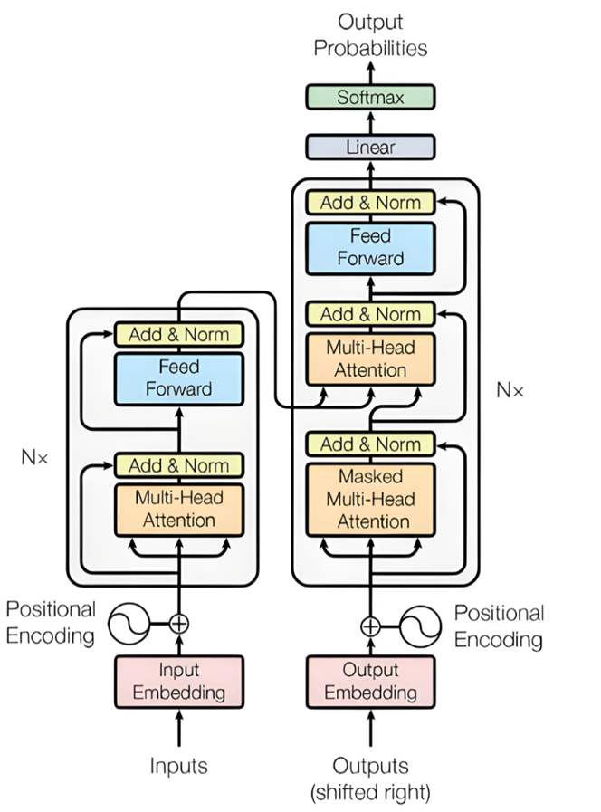

Model Architecture: Putting It All Together
The input and target sentences are embedded, $E$ and $G$
$E$ given to the encoder
The encoded $E$ is given to each decoder with part of $G$
The decoder stack will produce probabilities
Multiply probabilities with ‘dictionary’

Slide 19
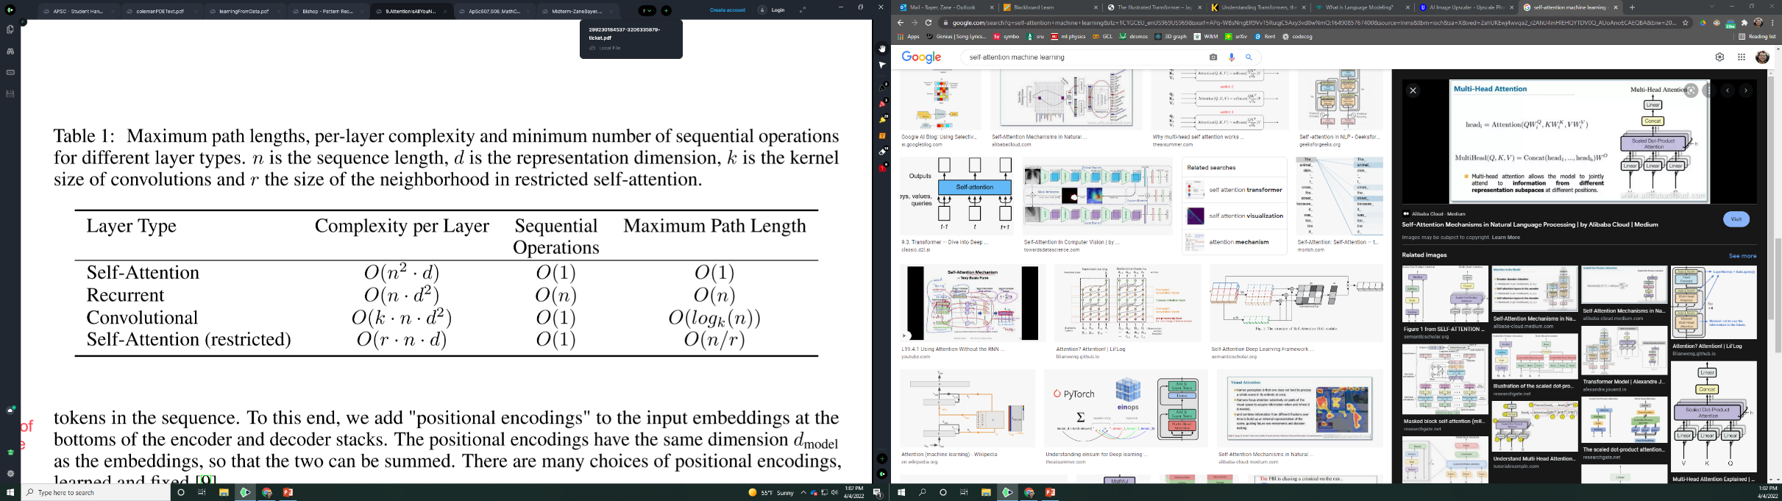
Why Self-Attention: Layer Complexities
Computational Cost
Parallelizability
Long-range Dependencies
$n:$ sequence length $d:$ representation dimensionality $k:$ kernel stride $r:$ neighborhood size

Slide 20
Training
The datasets:
WMT2014 English-German: contains about 4.5 million sentence pairs
WMT2014 English-French: contains 36 million sentence pairs
The base model was trained with 8 NVIDIA P100 GPUs for 12 hours.
The Adam optimizer was used in training with a learning rate schedule of
Residual dropout and label smoothing are used for regularizing the model.
$lrate=d_{model}^{−0.5}∙min⁡(step_num^{−0.5}$,$step_num^{}∙warmup_steps^{−1.5})$

Slide 21
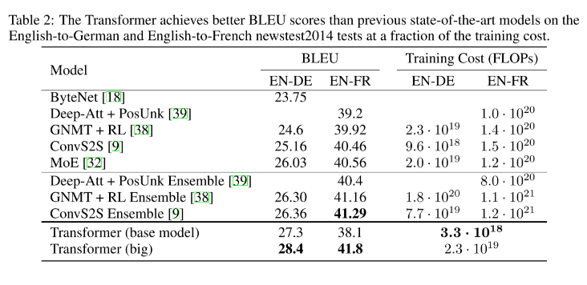
Results: Machine Translation

Slide 22
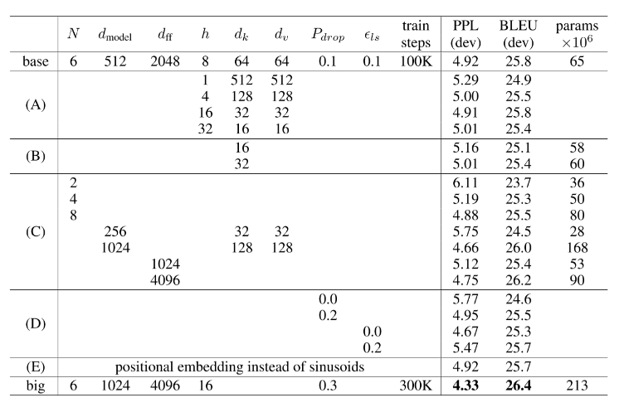


Results: Model Variations
Model variations were compared on a English-to-German dataset
(A) Performance deteriorates with too many attention heads
(B) Decreasing the attention key size $d_{k}$ hurts performance
(C) Larger models tend to perform better
(D) Dropout is useful in avoiding overfitting
(E) Learned positional embeddings perform nearly identically
N: Number of encoders/decoders
$d_{model}$: sublayer output size
$d_{ff}$: Number of hidden nodes in FFN
h: Number of multi-head attention heads
$d_{k}$: Number of keys
$d_{v}$: Number of values
$P_{drop}$: dropout rate
$ε_{ls}$: amount of label smoothing

Slide 23
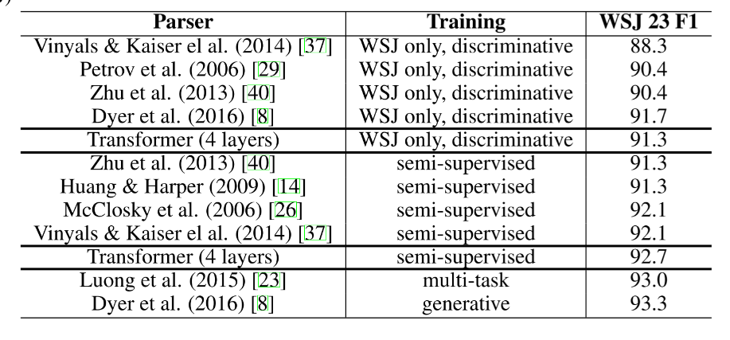
Results: English Constituency Parsing
As a test of generalization, the model was tested on a English constituency parsing which is the task of identifying subject, verb, article, etc. in text using the Penn Treebank dataset

Slide 24
The Authors’ Conclusions
The transformer was introduced as the first model based entirely on attention
The transformer model can be trained significantly faster than recurrent or convolution based models
The transformer achieved state of the art results WMT 2014 English-to-German and English-to-French datasets
Future work could focus creating transformer-like models for other datatypes such as images, audio, etc.

Slide 25



Since 2017
Transformers have achieved state of the art (or near) results in many deep learning disciplines
Research into extending the transformer architecture to other datatypes is still highly active.
Some notable achievements and developments:
OpenAI’s GPT-3 model makes headlines around the world
DeepMind’s AlphaFold2 makes groundbreaking success in predicting protein folding
Google researchers publish ‘An Image Is Worth 16x16 Words’
Transformers for video, graph, audio, and times series data have all been designed and published

Slide 26
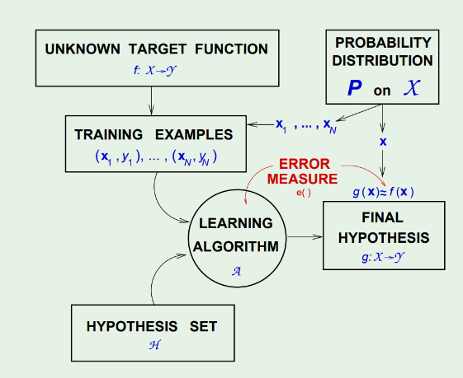
Tying In the Learning Diagram
For a transformer performing machine translation
Unknown target function: True translation from language 1 to language 2
Training examples: Pairs of sentences in both languages
Hypothesis Set: All possible transformers
Learning algorithm: Adam
Probability Distribution: distribution of possible English sentences
Error measure: BLEU score
Final Hypothesis: Best performing transformer found by Adam using BLEU score

Slide 27
Thank you for your time,
questions?

